Slide 1
Sales Data Analysis
Project By
Esther Anthony Dick
@Red Bull Virtual Internship

Slide 2
Project Question
What is the total sales volume from 2017 -2021 by account type?
What account type are best performing or worst in performance?
Are the products available to each account/account type?
What promotion is most effective for each account type?
The tool utilized for this analysis was Microsoft Excel and Power Query

Slide 3
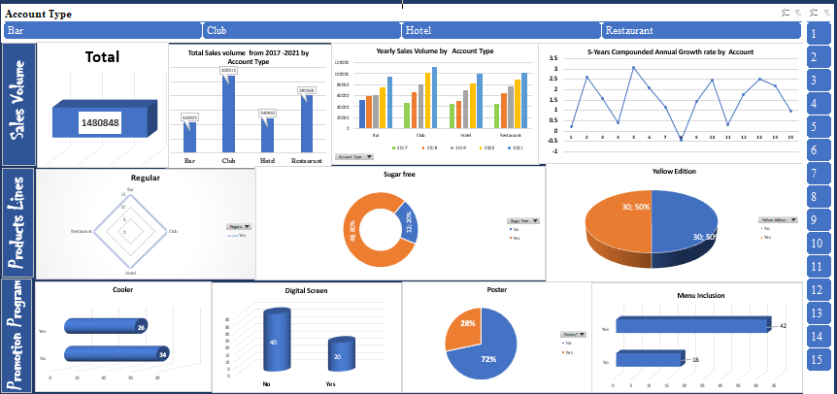
Sales Manager Dashboard

Slide 4
Total Sales Volume from 2017 -2021 by Account Type
The company had a total sale volume of 1,480,848 from 2017 - 2021

Slide 5
Sales Growth by Account Type (2017 -2021)
Notes:
Club rose to become the highest at 112,270 in 2021 although, it began as the second-lowest at 47,259 in 2017.
Restaurant it rose to be the second-leading account at 102,185 with annual average growth rate of 20%.

Slide 6
Sales Growth by Account Type (2017 -2021)
There are four account type (bar, club, hotel and restaurant) and 15 accounts numbered 1-15.
Club sales volume was higher all through the years at a minimum of 20% increase per annum.
Restaurant sales volume increased rapidly starting at 46,025 in 2017.
Hotel began as the least account sales volume in 2017 but increased steadily.
Bar continuously experienced fluctuating increase of at least 10% annually.
Notes:
Club rose to become the highest at 112,270 in 2021 although, it began as the second-lowest at 47,259 in 2017.
Restaurant it rose to be the second-leading account at 102,185 with annual average growth rate of 20%.

Slide 7
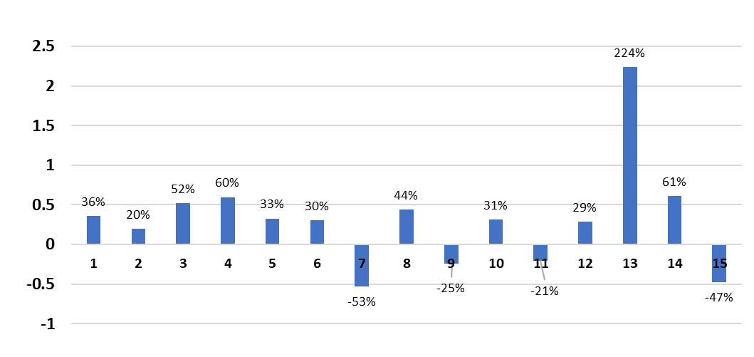
Sales Growth by Account and Account Type (1)
Bar
The 5 years compounded annual growth rate reveals that bar 13 had the highest growth rate at 224%.
Bar 7, 9, 11 and 15 had significant losses in sales volume, Bar 7 and 15 had growth loss at 53% and 47% respectively.

Slide 8
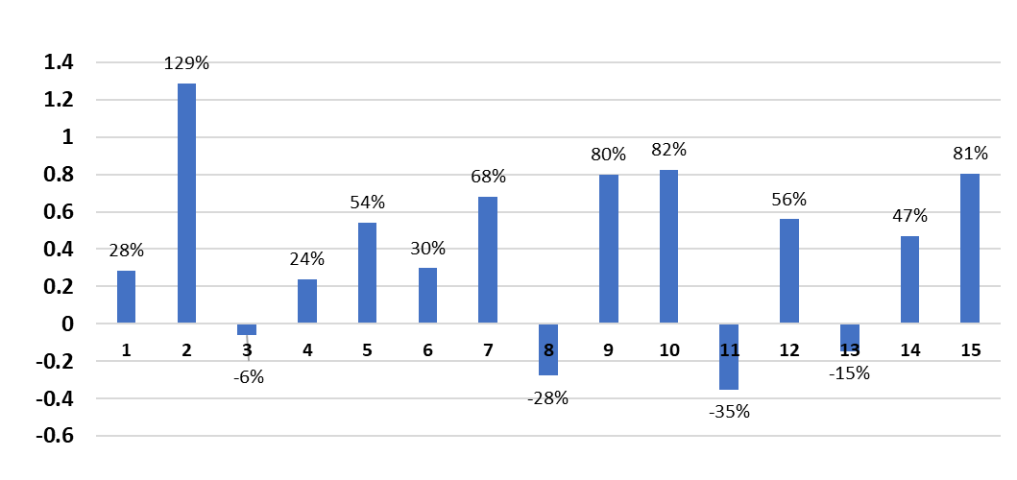
Sales Growth by Account and Account Type (2)
Club
The 5 years compounded growth reveals that club 2 and 10 had the highest growth rate at of 129% and 82% respectively
Club 3, 8, 11 and 13 had loss in sales volume, hotel 1 had the highest growth loss at 35%

Slide 9
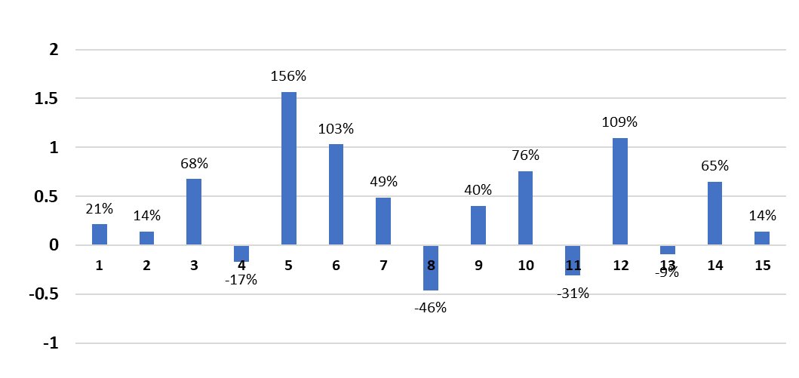
Sales Growth by Account and Account Type (3)
Restaurants
The 5 years compounded growth reveals that Restaurant 5 had the highest growth rate at of 156%
Restaurant 5 is closely followed by Restaurant 12 at 102%
Restaurant 4, 8, 11, 13 experienced growth loss but restaurant 8 had the highest at 46%

Slide 10
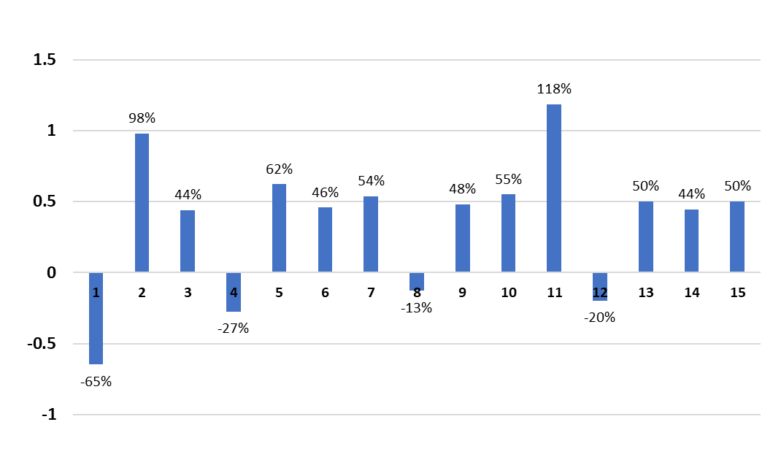
Sales Growth by Account and Account Type (4)
Hotel (Event Venue)
The 5 years compounded annual growth reveals that Hotel 11 and 2 had the highest growth rate at of 118% and 98% respectively
Hotel 1, 4, 8, and 12 had significant loss in sales volume, hotel 1 had the highest growth loss at 65%.

Slide 11
Best and Worst Performing Accounts by Account Type (5 Year CAGR)
Top 2 Accounts
Bar | Restaurant | Club | Event Venue
13 | 5 | 2 | 2
14 | 12 | 10 | 11
Bottom 2 Accounts
Bar | Restaurant | Club | Event Venue
7 | 8 | 8 | 1
15 | 11 | 11 | 4

Slide 12
Product Lines
There are 15 accounts for each account type (Bar, Club. Hotel restaurant) making it altogether 60 accounts.
100% of regular product was available in all the outlets, that is the 15 accounts of bar, hotel, club and restaurant.

Slide 13
Product Lines…
The product ‘Sugar free’ was available also but not in all accounts. About 20% did not have sugar free.
The yellow edition product was only available in 30 (50%) out of the 60 accounts.

Slide 14
Cooler Promotion Program
26 out of the 60 accounts participated in the cooler promotion program, 34 did not participate.
Break down of the 26 participants
Bar = 8
Club = 8
Hotel = 2
Restaurant = 8

Slide 15
Digital Screen Promotion Program
20 out of the 60 accounts participated in the digital screen promotion program, 40 did not.
Break down of the 20 participants
Bar = 8
Club = 7
Hotel = 0
Restaurant = 5

Slide 16
Menu Inclusion Promotion Program
42 out of the 60 accounts participated in the menu inclusion promotion program, 18 did not.
Break down of the 42 participants
Bar = 12
Club = 12
Hotel = 10
Restaurant = 8

Slide 17
Poster Promotion Program
17 (28%) out of the 60 (100%) sales point participated in the Poster Promotion Program.
Only 43 (72%) sales point did not participate in the Poster promotion program.
Breakdown of the 17 participants
Bar = 7
Club = 10
Hotel = 0
Restaurant = 0

Slide 18
Observations and Key Takeaways
Most Bar accounts participated in all the promotion/marketing programs, but still experienced low sales growth. Could it be that the promotion programs were not effective for the bars?
Event venue accounts only participated in menu inclusion and cooler promotion programs but it emerged in second-place lowest position in sales volume and compounded annual growth rate.
Club accounts participated in all the marketing/promotion programs and ranked as the highest in the sales volume. It may be that the promotion programs were effective for its consistent increase in growth rate?
The restaurant accounts participated in all promotion programs except for poster promotion and it performed relatively better than bar and hotel accounts in its sales volume.
Accounts that had all three products available performed better than those that did not or had only regular products.

Slide 19
Recommendation
All account type (bar, club, hotel and restaurant) should be supplied the three products consistently.
Further analysis to examine and predict the effectiveness of each promotion/marketing program.

Slide 20
THANK YOU FOR YOUR ATTENTION

